Slide 1

Capital Bike Share LLC Case Study
A Predictive Study using Azure ML
By
Raaga Jc

Slide 2









Content
1. Business Case - Bike Rentals Count effected by certain parameters
2. Data Acquisition - Data obtained in CSV format
3. Data Preparation -Data Cleaning through Azure
4. Data Visualization -Descriptive Statistics through Tableau and RStudio(Create_Report)
5. Exploratory Data Analysis - Independent Features Selected for further analysis
6.Feature Significance Testing -Performing Feature Importance Analytics using Chi-Squared Testing
7.Evaluation - Applied Chi square for Categorical and correlation for Numeric Variables.
8.Conclusion -Predictive Analysis
9.Operationalisation -Prescriptive Analysis

Slide 3



Data Preparation
17379 rows and 17 columns of Data with No Duplicate Values.
Selected 12 Columns without Noise and Cheater/Feeder Variables.
No Missing Values in Data Summarization. Proceed to Exploratory Data Analysis

Slide 4
Exploratory Data Analysis
Features(Variables) have been classified in to 5 categories – Predictor, Noise, Feeder,Independent, Redundant and Ignored.
Predictor(Y)
Variable
Noise Features
Feeder or
Cheater Features
Independent Variables
Season
Mnth
Windspeed
Holiday, hr
Weekday
Workingday
Weathersit
Temp, Atemp
hum
Cnt
(Count)
Instant
Dteday
yr
Casual
Registered

Slide 5

Data Visualization

Slide 6
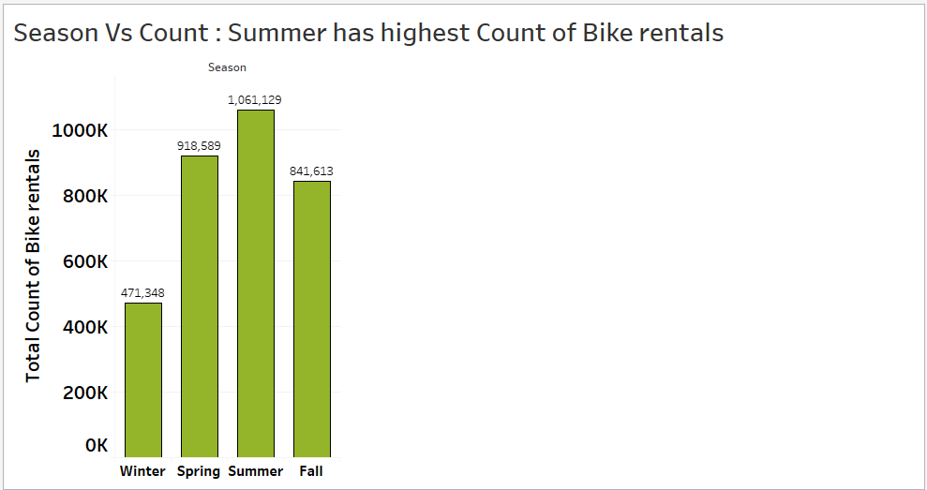
Season Vs Count
In all the 4 Seasons like Summer, fall, Winter and Spring.
Summer has highest count of Rentals.
Next to Summer, Spring has its highest count

Slide 7
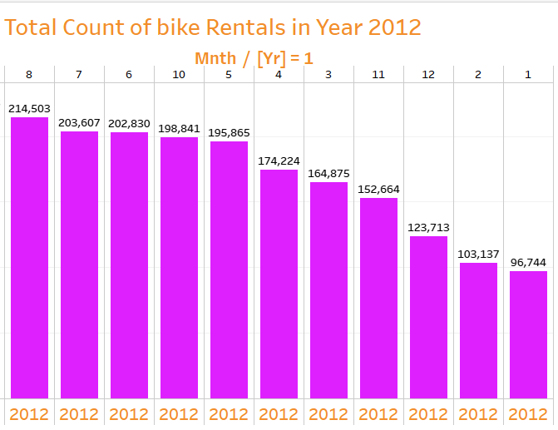
Bike count Vs Month
Bike Count is high in Mostly Summer time i.e, from Month May to August, As the temperature would be pretty good, More people tend to go for biking.

Slide 8
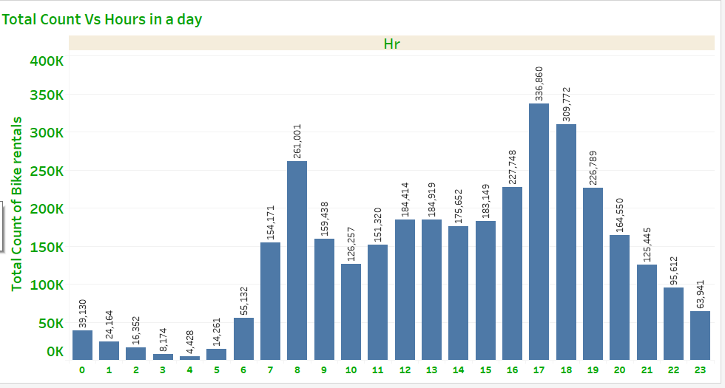
Busiest hour
In the morning busiest hour is 8’oclock and in the evening people grab more bikes@5pm.
In the Afternoon the highest counts were observed around 12 and 1’o clock.

Slide 9
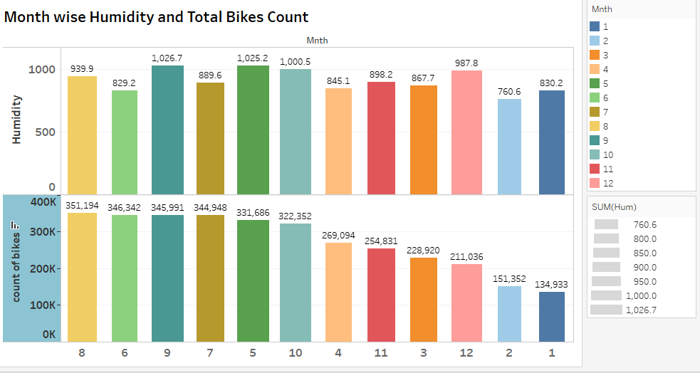
Humidity Vs Count
According to Exploratory Data Analysis Report from Azure ML, Humidity is Negatively Corelated with a value of -0.69.
So humidity Might effect Total Count of Bikes.

Slide 10
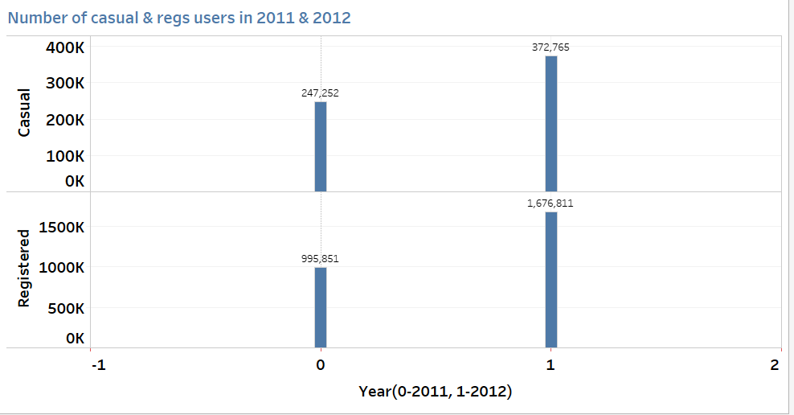
Registered Vs Casual
Total Count of Registered users is always greater than causal users count and the respective counts increased from the year 2011 to 2012

Slide 11
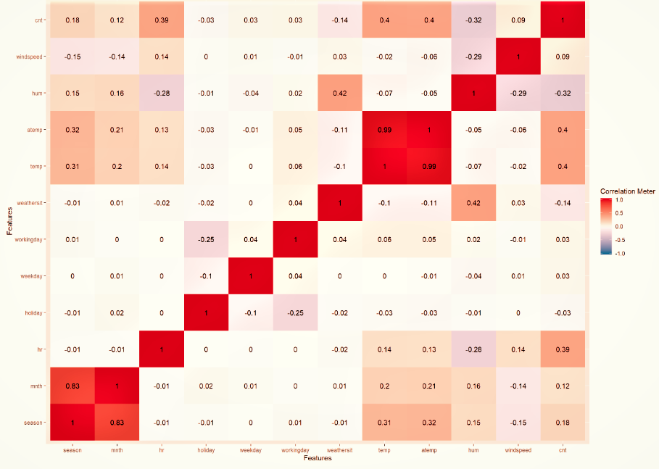
Capital Bike Share DataSet Corelation Analysis Test Report
Season Mnth hr holidy weekdy workingdy wtrSit Temp atemp hum wndsp Count

Slide 12
Conclusion
So from the Corelation Report, the total number of Bikes count is majorly influenced by the features
Season
Month
Hour
Holidays, Weekday, working day most likely does not effect the Bikes count.

